Slide 1
SOCIAL MEDIA APP & AUTOMATION
Department of CSE
Jyothi Engineering College
Thrissur
January 22, 2021
SOCIAL MEDIA APP & AUTOMATION

Slide 2
Department Mission & Vision
Vision
Creating eminent and ethical leaders in the domain of computational sciences through quality professional education with a focus on holistic learning and excellence.
Mission
To create technically competent and ethically conscious graduates in the field of Computer Science & Engineering by encouraging holistic learning and excellence.
To prepare students for careers in Industry, Academia and the Government.
To instill Entrepreneurial Orientation and research motivation among the students of the department
To emerge as a leader in education in the region by encouraging teaching, learning, industry and societal connect.
SOCIAL MEDIA APP & AUTOMATION

Slide 3
OUR TEAM
GROUP MEMBERS
Guide
Mr. Shaiju Paul
1
Divya Peter (JEC17CS044)
Eljo Joy
(JEC17CS045)
Akash Kumar (JEC17CS012)
Jackson James (JEC17CS052)
Assistant prof,Dept. of CSE
2
3
4
SOCIAL MEDIA APP & AUTOMATION

Slide 4
Introduction
• In the early 2000s, the primary purpose of mobile phones was to communicate by calling or texting an interlocutor
• Mobile phones have become tools that have changed our world, allowing users to entertain themselves learn, and search for information faster and more efficiently
• Our project is a platform for generating applications for educational institutions
SOCIAL MEDIA APP & AUTOMATION

Slide 5
Objective
• To access the application easily to every colleges
•To reduce the time taken and the cost needed for creating a social media application
•Limited expense is needed for its maintenance
SOCIAL MEDIA APP & AUTOMATION

Slide 6
Literature Survey Reference Paper-1
Simulating User Interactions: A Model and Tool for Semi-realistic Load Testing of Social App Backend Web Services
Many mobile apps today support interactions between their users and/or the provider within the app.
Simulating interacting users of a social app is proposed and evaluated by implementing it in a prototype load testing tool and using it to test a backend of new real-world social app
Adaptability to test different OSN backends needs to be demonstrated by evaluating the tool in various scenarios, in lab tests as well as in practice.
1
2
3
SOCIAL MEDIA APP & AUTOMATION
Notes:
HELLO
LITERATURE SURVEY VACHO
ITH ENTE NJAN VAKKAM
ithe ninte papera/?
YES
appo adv and dis mathinne alle parnje
NJAN INTRO ADV DISADV ellam ithil thanne vakkunne
aah okay
pinne parayumbol anghane present cheytha mathi

Slide 7
Literature Survey Reference Paper-2
Application of Low-Cost Methodologies for Mobile Phone App Development
The aims of this research article are to:
Highlight a low-cost methodology that clinicians without technical knowledge could use to develop educational apps.
Illustrate how limitations pertaining to dissemination could be addressed. As the apps are not in the respective app stores, it might be hard for dissemination of the apps as well.
There are various online Web-based mobile phone app builders such as Conduit Mobile and IbuildApp.
Users could access the application via a Web-link.
1
2
3
4
SOCIAL MEDIA APP & AUTOMATION
Notes:
kazhinju
eljone nee velthu typeeyinda?
aah
githubinn venda ath mathi
aah okay athe ninakku overleaf lu keraan pattindo? njan link ayachindu
nokate
vannatila
evidya vera?

Slide 8
Literature Survey Reference Paper-3
An Empirical Evaluation of the User Interface Energy Consumption of React Native and Flutter
Energy efficiency is a growing area of concern for mobile developers.
React Native and flutter are leading platform in mobile application development.
Measuring overall energy use between both platform is necessary to make the right choice.
Comparison can be done between energy use of the React Native and Flutter frameworks while performing User Interface tasks to the native Android API
1
2
3
4
SOCIAL MEDIA APP & AUTOMATION
Notes:
ith jackson nte alle
nee ee paper github lu upload cheytha?? ER complete aayo?

Slide 9
Literature Survey Reference Paper-4
An Introduction to Hybrid Platform Mobile Application Development
Hybrid platform mobile applications help in cost cutting and saving time as well as providing components for easier development of applications.
The aims of this research article are to:
to help developers make the right choice in order to build an application
to give vital information about hybrid platform mobile application approaches
advantages and disadvantages hybrid platform mobile application .
1
2
SOCIAL MEDIA APP & AUTOMATION
Notes:
ith Akash nte

Slide 10
Literature Survey Reference Paper-5
Efficient Way Of Web Development Using Python And Flask
Web is the most frequently used networking aid which satisfies the requirements of all types of users
While developing a web portal the appearance of web portal makes a development more critical
Flask is a better technology for designing and developing a well structured and with the good appearance of web.
The technological needs of satisfying a good web portal can be fulfilled by "python" and "flask
1
2
3
4
AUDIO BASED DRONE DETECTION AND IDENTIFICATION USING DEEP L
Notes:
coomon paper

Slide 11
Modules of Proposed System
1. Website Creation
2. Data Collection
3. Automation
4. Application
SOCIAL MEDIA APP & AUTOMATION

Slide 12
SRS-Functional Requirements
1. Automation of Application development
2. User Interface - User
3. User Interface - Admin
SOCIAL MEDIA APP & AUTOMATION

Slide 13
SRS-Non Functional Requirements
1. Performance Requirements
2. Safety Requirements
3. Security Requirements
4. Software Quality Attributes
SOCIAL MEDIA APP & AUTOMATION

Slide 14
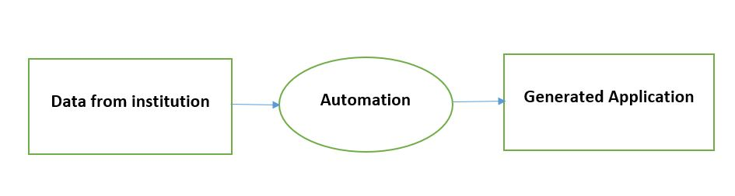
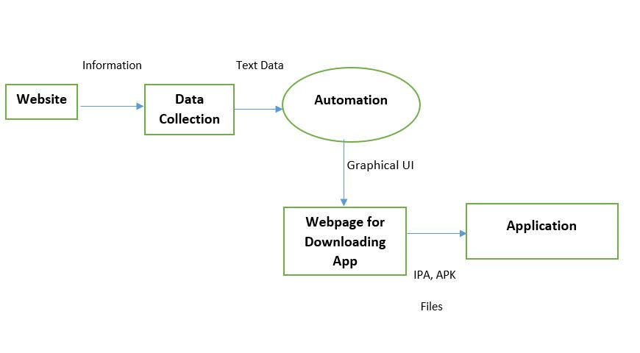
DFD
Figure: Level 0
Figure: Level 1
SOCIAL MEDIA APP & AUTOMATION

Slide 15
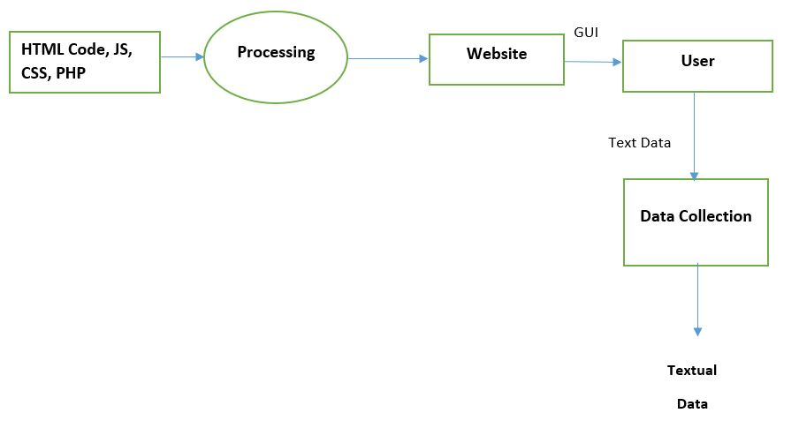
DFD CONTD...
Figure: Level 2.1
SOCIAL MEDIA APP & AUTOMATION

Slide 16
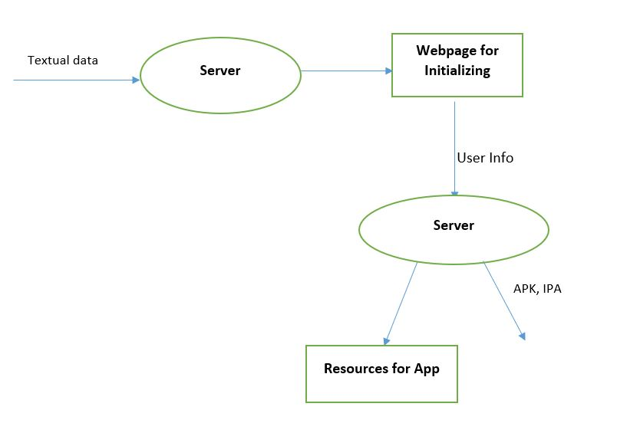
DFD CONTD...
DFD CONTD….
Figure: Level 2.2

Slide 17
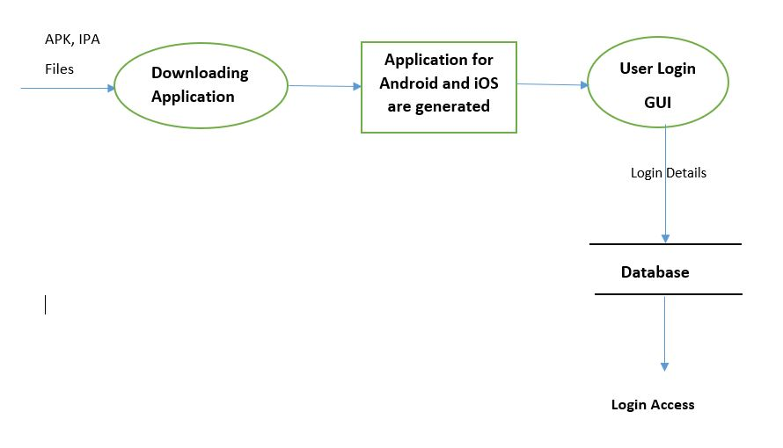
DFD CONTD...
Figure: Level 2.3

Slide 18
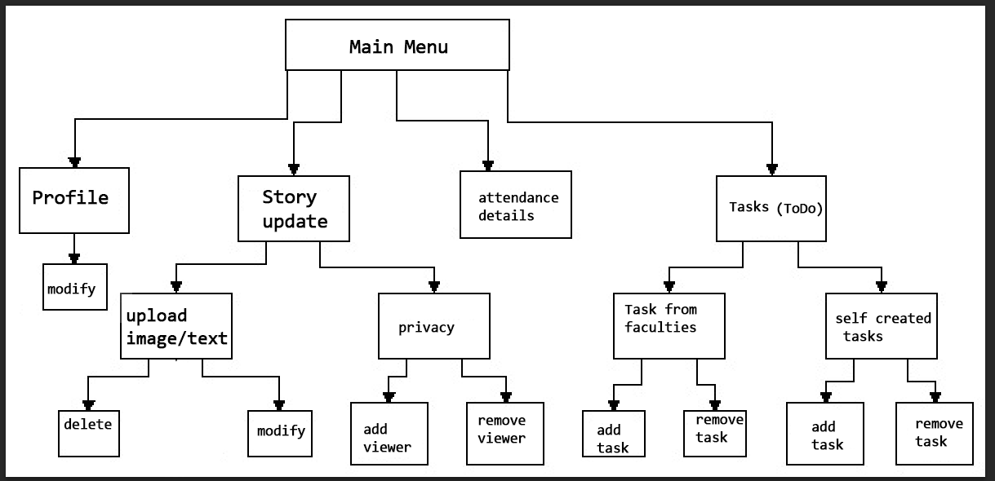
STRUCTURE CHART
Figure: structure chart

Slide 19
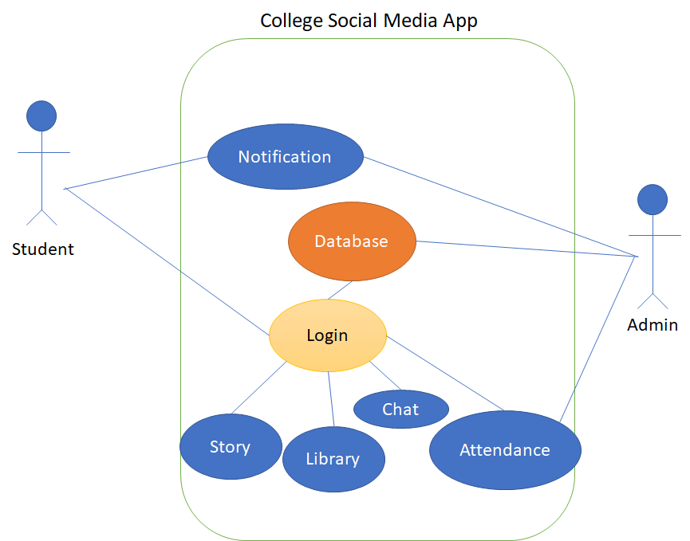
Use Case Diagram

Slide 20
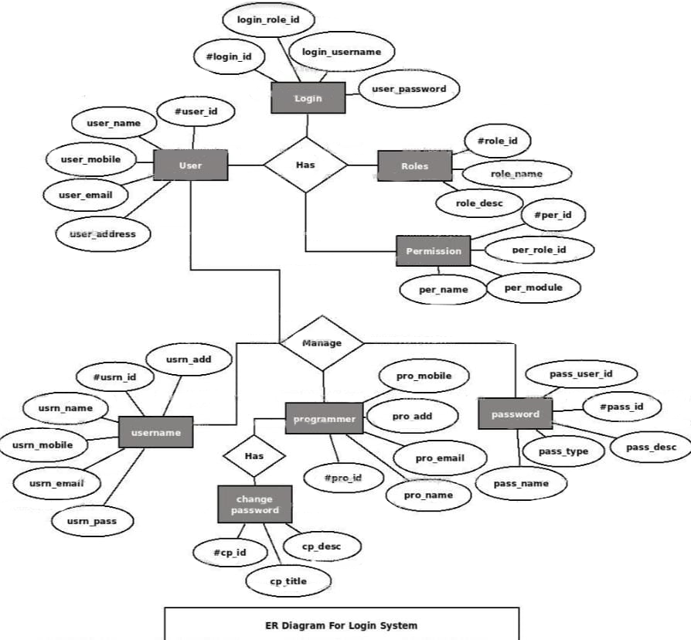
ER diagram
Figure: ER diagram

Slide 21
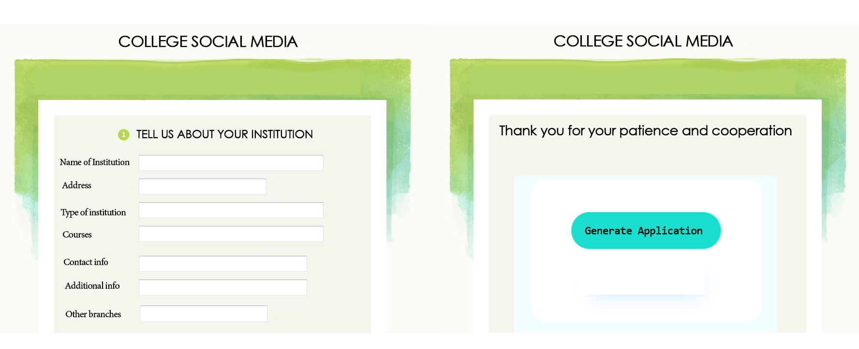
Expected Output
Figure: UML of WEB
SOCIAL MEDIA APP & AUTOMATION

Slide 22
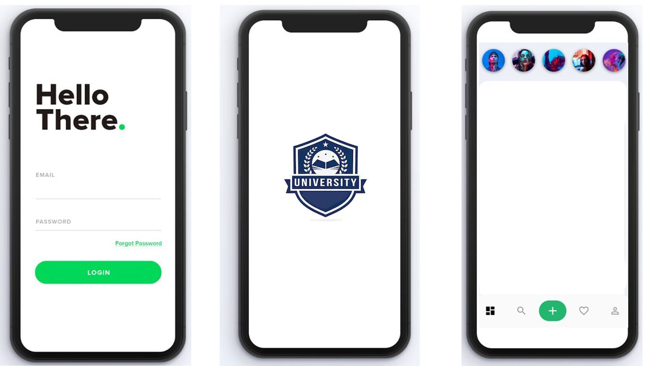
Expected Output CONTD..
Figure: UML of APP
SOCIAL MEDIA APP & AUTOMATION

Slide 23
Pending Work
Creating a template for social media app in flutter.
Which includes:
1) login system
2) story updation
3) chat system
4) attendance viewer
Creating a website for accessing data from clients.
Creating a server using flask for generating the app using the data from website.
Testing the generated application in different devices.
SOCIAL MEDIA APP & AUTOMATION

Slide 24
CONCLUSION
1
Nowadays people more attractive to applications than websites to access data
Applications are more simple to handle
Trespassers cannot access the application, so more secure
2
2
3
SOCIAL MEDIA APP & AUTOMATION

Slide 25
REFERENCES
Philipp Brune.
Simulating user interactions: A model and tool for semi-realistic load testing of social app backend web services. In
WEBIST, pages 235–242, 2017.
Zhang, Melvyn, et al. "Application of low-cost methodologies for mobile phone app development." JMIR mHealth and uHealth 2.4 (2014): e55.
Erik Blokland.
An Empirical Evaluation of the User Interface Energy Consumption of React Native and Flutter
Anmol Khandeparkar,Rashmi Gupta,B.Sindhya
An Introduction to Hybrid Platform Mobile Application Development .Volume 118 – No.15, May 2015
SOCIAL MEDIA APP & AUTOMATION

Slide 26
Thank You
Any Query?
SOCIAL MEDIA APP & AUTOMATION

